Slide 1

Customer Segmentation Using K-Means Algorithm
PAPER CODE : HCsds6043D
Meghna MONDAL (526)
Tanushree sarkar (529)
Kwanan Mondal (553)
Supervisor : PROF. Debabrata DAtta

Slide 2
INRODUCTION
Customer segmentation is the subdivision of a business customer base into groups called customer segments such that each customer segment consists of customers who share similar market characteristics[6].
This segmentation is based on factors that can directly or indirectly influence market or business such as products preferences or expectations, locations, behaviour and so on
Types of Segmentation :
Demographic : Segmentation based on age, gender, income, education, occupation, and family status.
Psychographic : Segmentation based on customers customer personality, values, attitudes, and lifestyles
Behavioural : Segmentation based on buying habits, usage patterns, loyalty, and engagement
Geographic : Segmentation based on geographical location such as zip code, region, city, climate, or even neighbourhood

Slide 3
Benefits of analysing customers using customer segmentation :
Improve product delivery
Boosts process efficiency
Helps us target content marketing and sales outreach
Update pricing, plans and strategy
Improves customer relationships
Create new offers , products and services
Improves brand awareness
Stay ahead of competitors
Track product sentiments

Slide 4
Clustering has been proven effective to implement customer segmentation.
Clustering comes under unsupervised learning, having ability to find clusters over unlabelled dataset
There are a number of clustering algorithm like :
K-Means
Hierarchical clustering
Fuzzy Clustering
Density-Based Clustering

Slide 5
BACKGROUND LITERATURE SURVEY
Jain, Murty, and Flynn's paper, "Data Clustering: A Review“ [16] | “Clustering in Data Mining: A Survey," by Xu and Wunsch[13] | MacQueen's paper "Some Methods for Classification and Analysis of Multivariate Observations" [14] | "Introduction to Data Mining" by Tan, Steinbach, and Kumar[15]
Classification of clustering algorithms, including partitioning methods. Evaluation measures, like silhouette coefficient. Challenges and issues associated with clustering. | Large datasets. Highlights the importance of selecting appropriate evaluation measures. Covers some recent developments in clustering, such as clustering with uncertain data. | Proposed k-means clustering algorithm. Selection of the number of clusters, ‘k’. Practical considerations, such as dealing with empty clusters. | Discuss various data mining techniques and algorithms ,such as decision trees and k-means. Illustrates on how data mining is used in various fields.

Slide 6

INTRODUCTION TO OUR WORK

Slide 7
In this project we have focused on Behavioural and Geographical segmentation and implemented it with the help of K-Means Clustering Algorithm over 2 sets of data
1. Behavioural Segmentation :
Behavioural data helps us identify how customers interact with the business
Offers marketers and business owners a more complete understanding of their audience , thus enabling them to tailor products or services to specific customers' needs
Why is behavioural Segmentation important :
Identify the most engaging user .
Improves messaging accuracy
Provides refined personalized experiences
Builds brand loyalty

Slide 8
2. Geographical Segmentation:
Geographical segmentation is a market strategy used to target products or services at people who live in , or shop at , a particular location.
Works on the principle that people in that location have similar needs , wants and cultural considerations .
By understanding what people in that area require, brands can target more relevant who are then aware and more likely to buy.
Why is Geographical Segmentation important :
It makes the brand more relevant
Improves communication
Saves money
Increase profits
Drive growth

Slide 9
3. K-Means Algorithm
It is the simplest algorithm of clustering based on partitioning principle[2].
The algorithm is called k-means due to the fact that the letter k represents the number of clusters chosen [22].
[6] Generic k-means clustering Algorithms:
1) Decide on the number of clusters, k.
2) Initialize the k cluster centroids
3) Assign the n data points to the nearest clusters.
4) Update the centroid of each cluster using the data points therein.
5) Repeat steps 3 and 4 until the changes in positions of centroids are zero.
In clustering , distance measure plays a crucial role in determining the similarity or dissimilarity between data points.
4. Euclidean Distance :
A natural choice of distance is the Euclidean distance[5].
Calculates the straight-line distance between two datapoints on a plane .
This formula says the distance between two points(x1, y1) and (x2, y2) is d = √[(x2 – x1)2 + (y2 – y1)2].

Slide 10
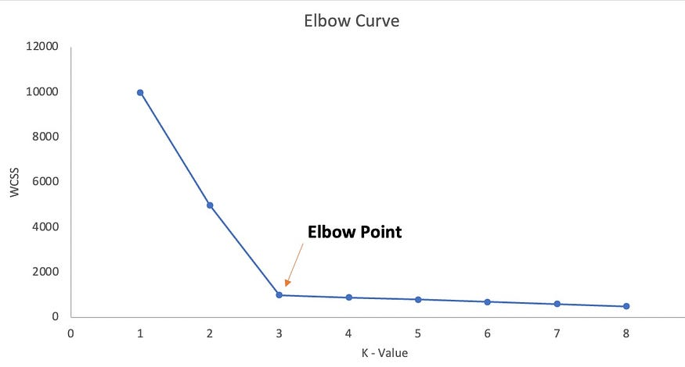
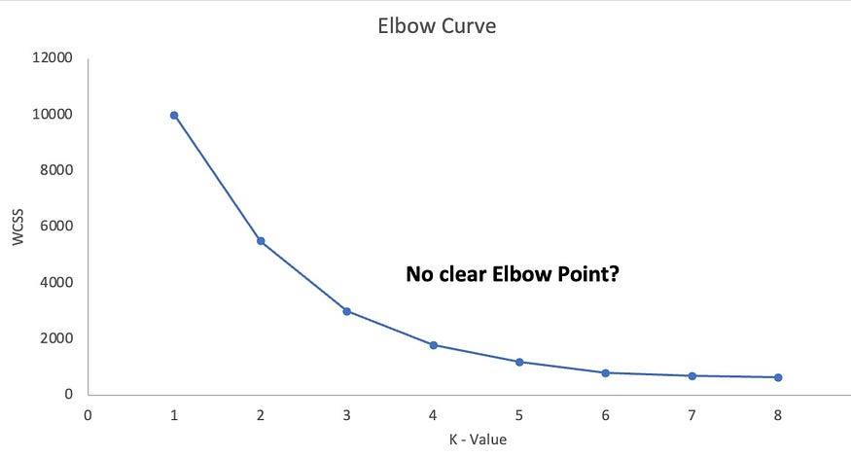
For finding the optimum value of k elbow method and silhouette score is used
5. Elbow Method :
Elbow graph is used for finding optimal value of K for K-means algorithm [2].
It involves plotting the within-cluster sum of squares (WCSS) against the number of clusters.
Fig 1: Expected Elbow curve
Fig 2 : Actual Elbow curve

Slide 11
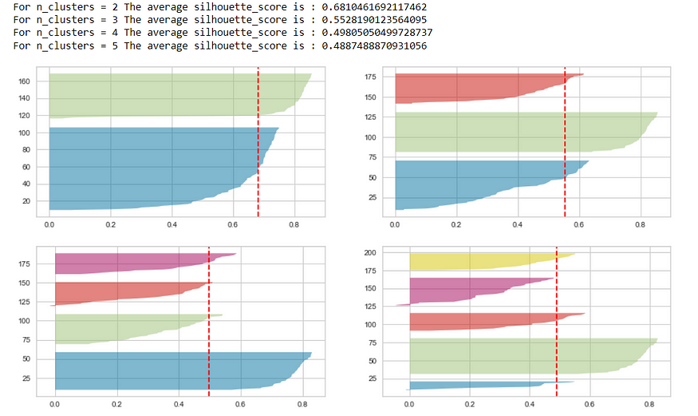
6. Silhouette Score :
When it is not clear what should be the elbow point, we validate the value of K using the silhouette plot.
Silhouette score is used to calculate the quantitative measure of the quality of the cluster .
Silhouette Score = (b-a)/ max(a,b)
where,
a = average intra-cluster distance (cohesion )
b = average inter-cluster distance (separation )
Conditions to check before selecting the k value using silhouette plots :
For a particular k , all the clusters should have a silhouette score more than the average score of the dataset
There should not be wide fluctuations in the size of the clusters .
Fig 3 : Silhouette plot for K=2 to 5

Slide 12
Workflow Diagram :
Data Collection
Data Pre-processing
Determine the Optimum number of clusters using Elbow Graph and Silhouette score
Apply k-means
Interpret the Results
Visualize the Clusters

Slide 13
Behavioral/Geographical Segmentation Using K-Means Algorithm
Gather data: Collect data on customer behavior/geographical location, such as age, annual income, spending score, area pin-code.
1
Preprocess data: Clean the data and transform it into a format suitable for clustering analysis.
2
Choose K: Decide how many clusters (K) you want to create based on the nature of the data and the business objectives.
3
Initialize centroids: Select K initial centroids at random or using a heuristic algorithm.
4
Assign points to clusters: Assign each data point to the nearest centroid based on the distance metric used (e.g., Euclidean distance).
5
Calculate cluster means: Calculate the mean of each cluster to get the new centroid location.
6
Repeat steps 5 and 6: Iterate steps 5 and 6 until convergence criteria are met (e.g., a maximum number of iterations or a small change in centroids).
7
Analyze results: Analyze the resulting clusters and their characteristics to gain insights into customer behavior and inform marketing strategies.
8

Slide 14
OUTPUT

Slide 15
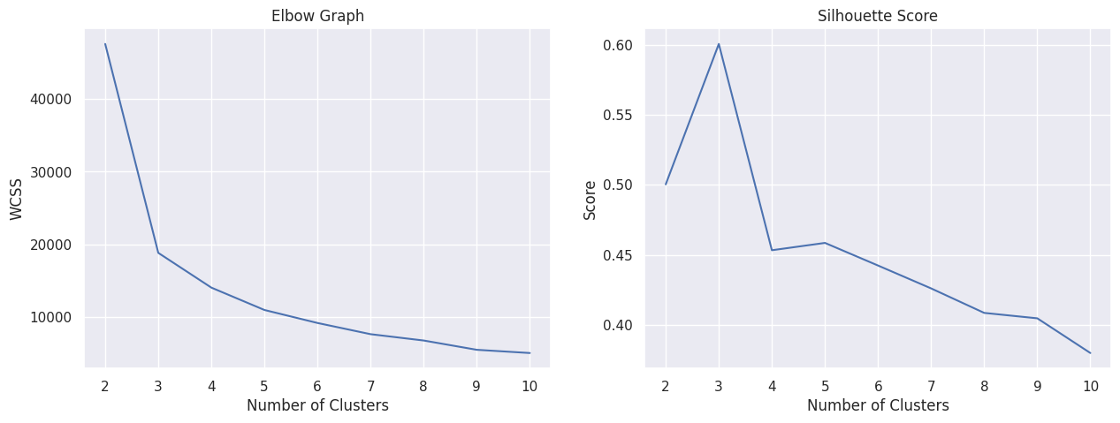
Dataset 1 : Annual Income VS Spending Score
Fig 4 : Elbow Graph and
Silhouette Score
Code Link :- https://colab.research.google.com/drive/12WwIQht7SUgXP4nCXb5fGb-5aNP3X3WA?usp=sharing

Slide 16
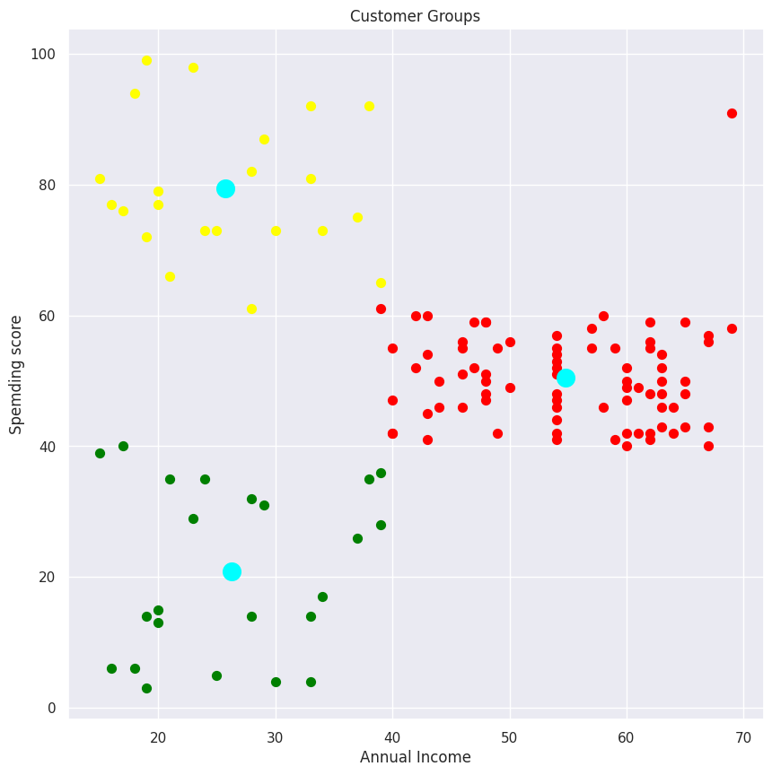
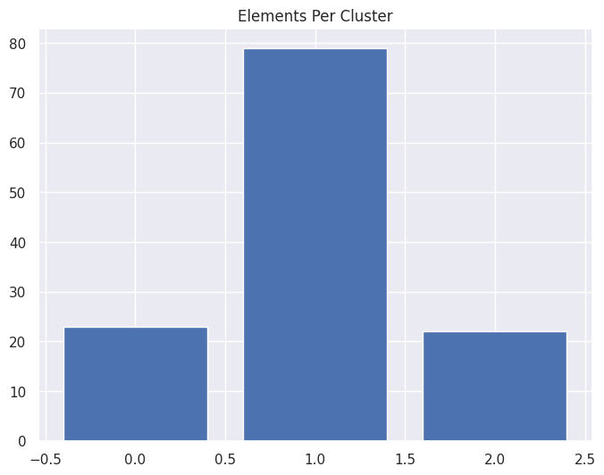
Dataset 1 : Annual Income VS Spending Score (cont.)
Fig 5 : Scatter Plot
Fig 6 : Bar Graph

Slide 17
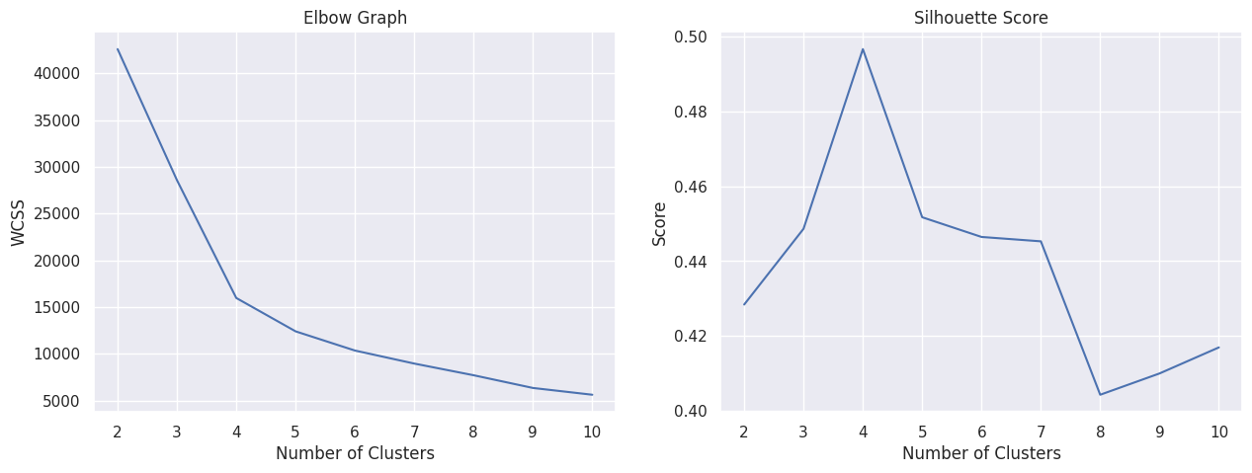
Dataset 1 : Age VS Spending Score
Fig 7 : Elbow Graph and
Silhouette Score
Code Link :- https://colab.research.google.com/drive/1-4Zxw5f74vOOld3qOlnmQxfhRIWinJtH?usp=sharing

Slide 18
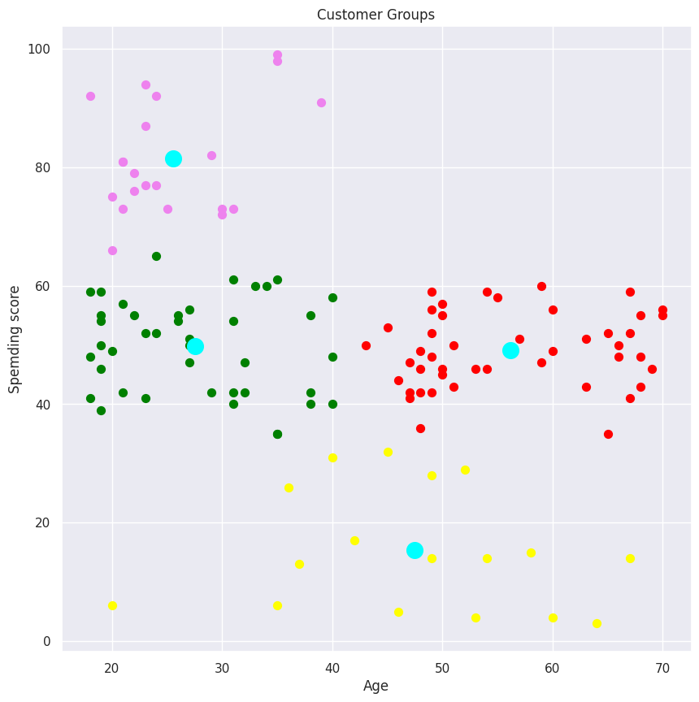
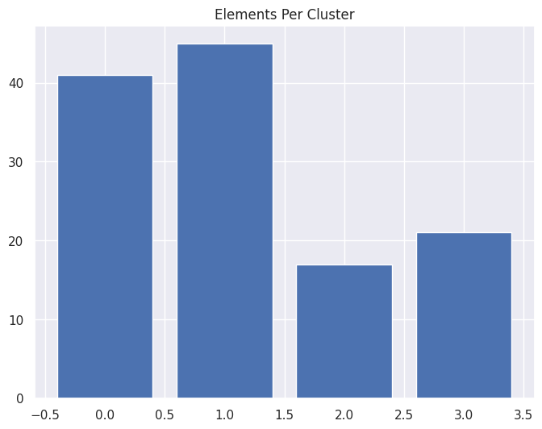
Dataset 1 : Age VS Spending Score (cont.)
Fig 8 : Scatter Plot
Fig 9 : Bar Graph

Slide 19
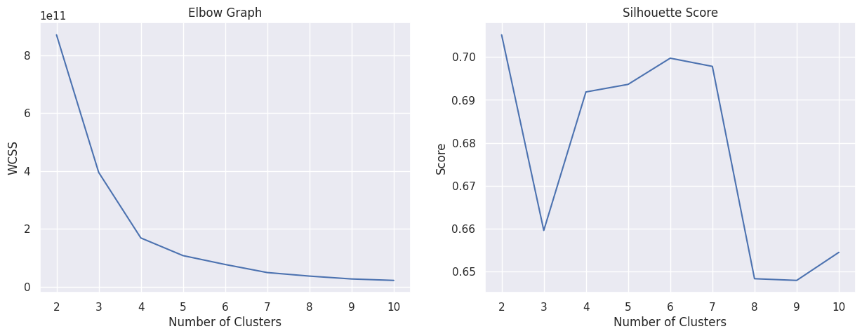
Dataset 1 : Pin Code VS Spending Score
Fig 10 : Elbow Graph and
Silhouette Score
Code Link :- https://colab.research.google.com/drive/1MnpNuXGuT3BG5VKA0PJ3eQmJcdV2LJxi?usp=sharing

Slide 20
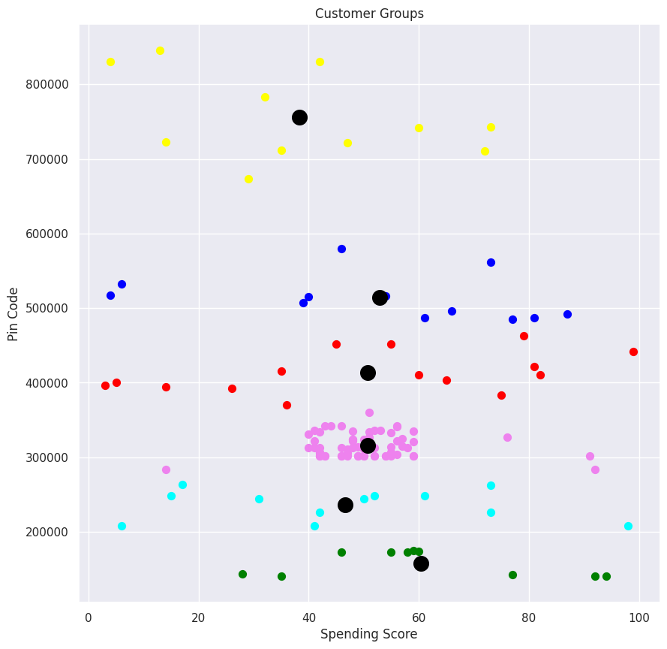
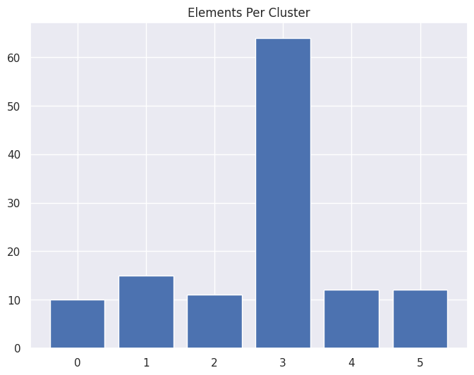
Dataset 1 : Pin Code VS Spending Score (Cont.)
Fig 11 : Scatter Plot
Fig 12 : Bar Graph

Slide 21
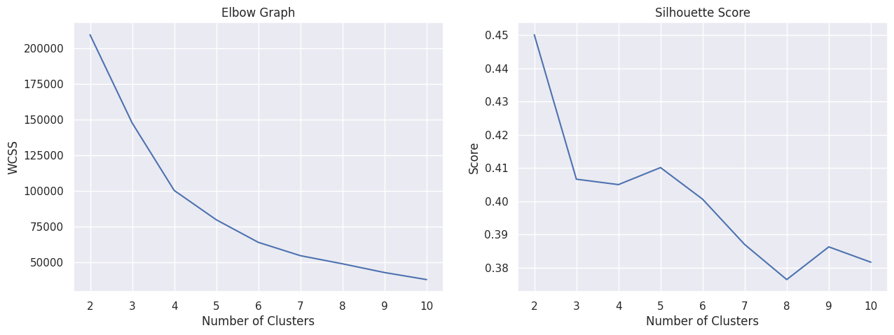
Dataset 2 : Annual Income VS Spending Score
Fig 13 : Elbow Graph and
Silhouette Score
Code Link :- https://colab.research.google.com/drive/1bsImnX6QoG5OEowBVQAeAp2oef1olrl-?usp=sharing

Slide 22
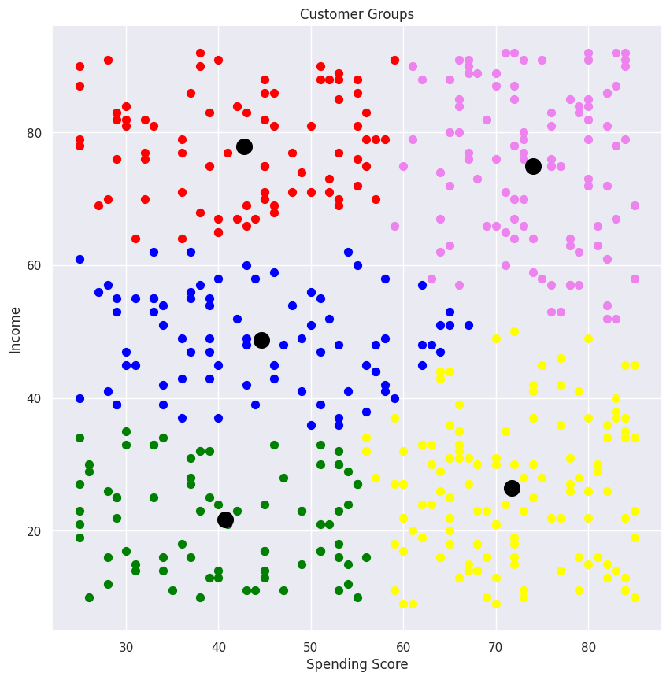
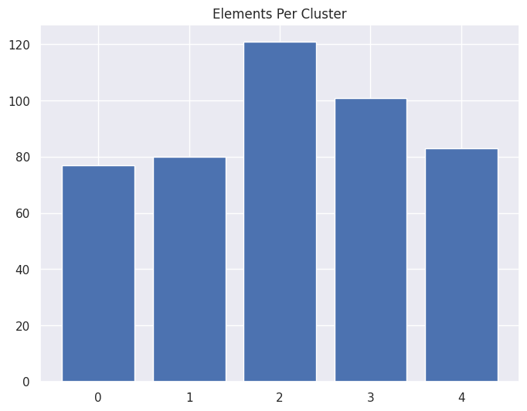
Dataset 2 : Annual Income VS Spending Score (cont.)
Fig 14 : Scatter Plot
Fig 15 : Bar Graph

Slide 23
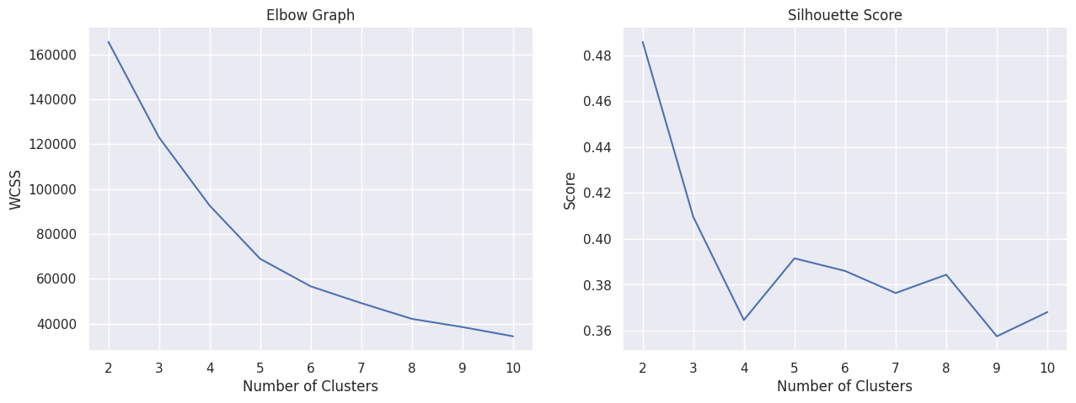
Dataset 2 : Age VS Spending Score
Fig 16 : Elbow Graph and
Silhouette Score
Code Link :- https://colab.research.google.com/drive/120NUtSLXrkth9GHGyI-YOcIqjSsPLKqw?usp=sharing

Slide 24
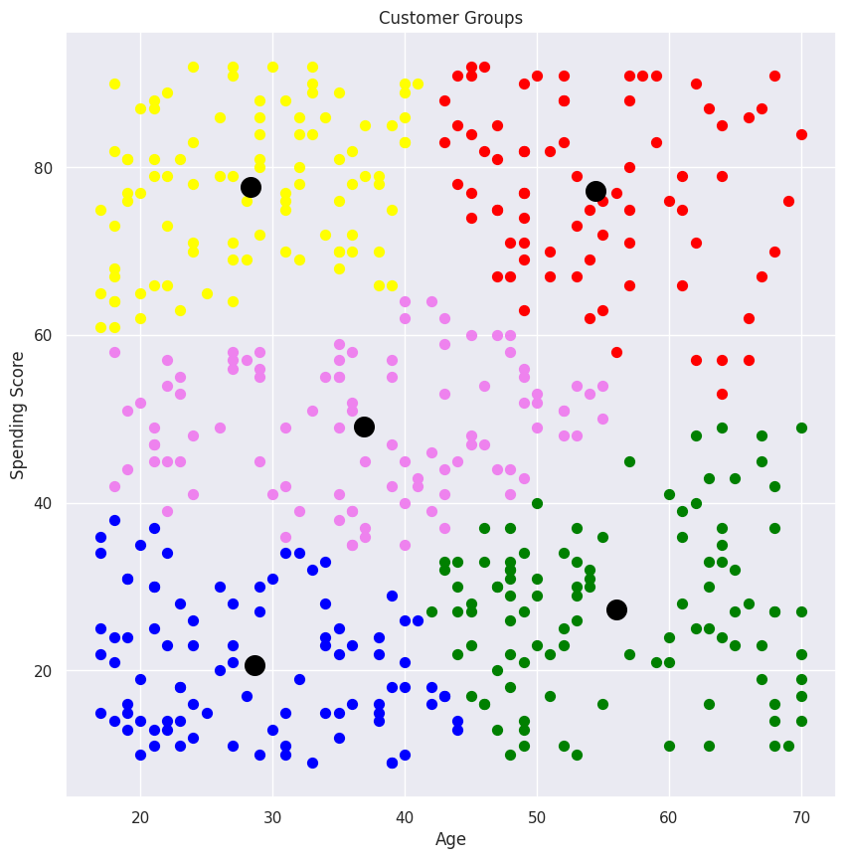
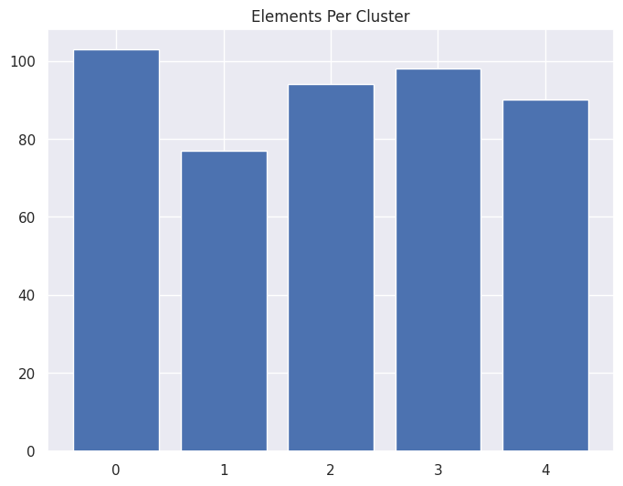
Dataset 2 : Age VS Spending Score (cont.)
Fig 17 : Scatter Plot
Fig 18 : Bar Graph

Slide 25
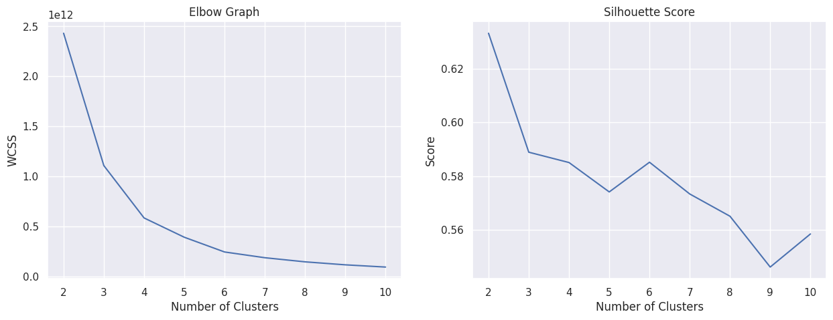
Dataset 2 : Pin Code VS Spending Score
Fig 19 : Elbow Graph and
Silhouette Score
Code Link :- https://colab.research.google.com/drive/1GzDM7xT7NSJyHR6tnjjysS6N9jzHnxQu?usp=sharing

Slide 26
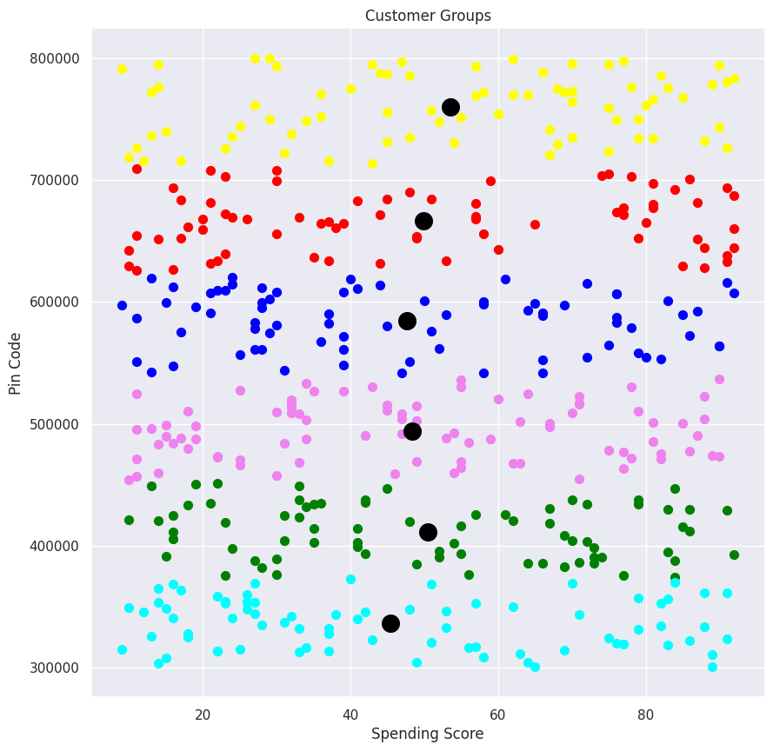
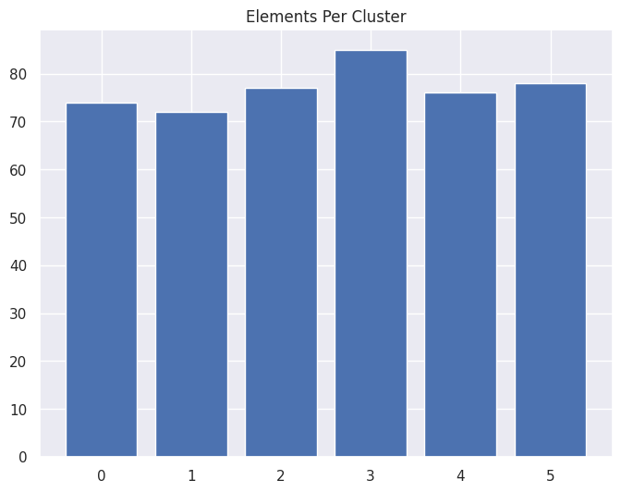
Dataset 2 : Pin Code VS Spending Score (cont.)
Fig 20 : Scatter Plot
Fig 21 : Bar Graph

Slide 27
SWOT ANALYSIS
STRENGTHS
K-means is a popular and widely used method for customer segmentation.
The elbow method and silhouette analysis evaluate the quality of the clustering results.
Help businesses better understand their customers' needs and preferences.
WEAKNESSES
K-means clustering assumes that the clusters are spherical, may not be true in real-world scenarios.
Quality of the clustering results depends on the choice of the initial cluster centers.
Customer segmentation requires a large amount of data and computational resources, which may be challenging for small businesses.
Advances in data collection and analysis techniques, can help enhance the accuracy and effectiveness of customer segmentation.
Integration of customer segmentation with other business processes, can provide valuable insights and improve overall business performance.
OPPORTUNITIES
Increasing concerns over data privacy and security may limit the availability and quality of customer data.
The competitive landscape in many industries is constantly changing, which may require businesses to adapt their customer segmentation strategies.
The reliance on automated algorithms and data-driven decision making may reduce the human element in customer interactions.
THREATS

Slide 28
REFFERENCES
[1] Jayant Tikmani, Sudhanshu Tiwari, Sujata Khedkar “Telecom customer segmentation based on cluster analysisAn Approach to Customer Classification using k-means”, IJIRCCE,Year: 2015.
[2] Tushar Kansal, Suraj Bahuguna ,Vishal Singh, Tanupriya Choudhury, “Customer Segmentation using K-means Clustering”, International Conference on Computational Techniques, Electronics and Mechanical Systems (CTEMS),2018.
[3] T. Kanungo, D. M. Mount, N. S. Netanyahu, C. D. Piatko, R. Silverman, and A. Y. Wu, “An efficient K-means clustering algorithm,” IEEE Trans. Pattern Analysis and Machine Intelligence,vol. 24, pp. 881-892, 2002.
[4] M. Inaba, N. Katoh, and H. Imai, “Applications of weighted Voronoi diagrams and randomization to variance-based k-clustering,” in Proc.10th ACM Symposium on Computational Geometry, 1994, pp.332-339.
[5] D. Aloise, A. Deshpande, P. Hansen, and P. Popat, “NP-hard Euclidean sumof-squares clustering,” Machine Learning, vol. 75, pp. 245-249, 2009
[6] Chinedu Pascal Ezenkwu, Simeon Ozuomba, Constance kalu Electrical/Electronics & Computer Engineering Department, University of Uyo, Uyo, Akwa Ibom State, Nigeria “Application of K-Means Algorithm for Efficient Customer Segmentation: A Strategy for Targeted Customer Services”, IJARAI,Year: 2015.
[7] SulekhaGoyat“The basis of market segmentation: a critical review of literature”, EJBM,Year: 2011.
[8] Vaishali R. Patel and Rupa G. Mehta “Impact of Outlier Removal and Normalization Approach in Modified k-Means Clustering Algorithm”, IJCSI,Year: 2011. [9]Scikit-learn: https://scikit-learn.org 81
[10] Tanupriya Choudhury, Vivek Kumar, Darshika Nigam, Intelligent Classification & Clustering Of Lung & Oral Cancer through Decision Tree & Genetic Algorithm, International Journal of Advanced Research in Computer Science and Software Engineering,2015
[11] Tanupriya Choudhury, Vivek Kumar, Darshika Nigam, An Innovative and Automatic Lung and Oral Cancer Classification Using Soft Computing Techniques, International Journal of Computer Science & Mobile Computing,2015

Slide 29
REFFERENCE (CONT.)
[12]Puwanenthiren Premkanth, ―Market Segmentation and Its Impact on Customer Satisfaction with Especial Reference to Commercial Bank of Ceylon PLC.‖ Global Journal of Management and Business Research Publisher: Global Journals Inc. (USA). 2012. Print ISSN: 0975-5853. Volume 12 Issue 1
[13]Xu, R., and Wunsch, D. (2005). "Clustering in Data Mining: A Survey." IEEE Transactions on Knowledge and Data Engineering, 16(3), 303-316. doi: 10.1109/TKDE.2004.68
[14]MacQueen, J. B. (1967). Some methods for classification and analysis of multivariate observations. Proceedings of the fifth Berkeley symposium on mathematical statistics and probability, 1(14), 281-297.
[15]Tan, P.N., Steinbach, M., and Kumar, V. (2006). "Introduction to Data Mining." Addison-Wesley, Boston, MA.
[16]Jain, A., Murty, M.N., and Flynn, P.J. (1999). "Data Clustering: A Review." ACM Computing Surveys, 31(3), 264-323.
[17] B. Huang, M. T. Kechadi, and B. Buckley, “Customer churn prediction in telecommunications, “Expert Systems with Applications, vol. 39, no. 1, pp. 1414– 1425.
[18] M. Farhadloo, R. A. Patterson, and E. Rolland, “Modelling customer satisfaction from unstructured data using a Bayesian approach,” Decision Support Systems, vol. 90, pp. 1–11.
[19] L. Luan and H. Shu, “Integration of data mining techniques to evaluate promotion for mobile customers' data traffic in data plan,” 2016 13th International Conference on Service Systems and Service Management (ICSSSM), 2016. 82
[20] A. A. Khan, S. Jamwal, and M. Sepehri, “Applying Data Mining to Customer Churn Prediction in an Internet Service Provider,” International Journal of Computer Applications, vol. 9, no. 7, pp. 8–14.
[21] Y. Huang and T. Kechadi, “An effective hybrid learning system for telecommunication churn prediction,” Expert Systems with Applications, vol. 40, no. 14, pp. 5635–5647.
[22] Kishana R. Kashwan,” Customer Segmentation Using Clustering and Data Mining Techniques” in International Journal of Computer Theory and Engineering · January 2013. [23] A. Vattani, “K-means exponential iterations even in the plane”, Discrete and Computational Geometry, vol. 45, no. 4, pp. 596-616, 2011.
[24] C. Elkan, “Using the triangle inequality to accelerate K-means,” in Proc. the 12th International Conference on Machine Learning (ICML), 2003. [25] H. Zha, C. Ding, M. Gu, X. He, and H. D. Simon, “Spectral Relaxation for K-means Clustering,” Neural Information Processing Systems, Vancouver, Canada, vol.14, pp. 1057-1064, 2001.

Slide 30

Thank You

